Slide 2
HRM Resources for Week 1
Hulley Chapter 1 - Getting Started: The Anatomy and Physiology of Clinical Research
Internationl Stroke Trial
Research Question

Slide 3
Course Overview
Describe, Compare, Predict Framework
What is your research question?
PICOT
Linking study design to research question
Overview of study designs

Slide 4
Describe, Compare, Predict (DCP)
Definition of health research
The importance of health research
Examples of health research

Slide 5
What is your research question?
Population
Sample
Variable
Data
Hypothesis

Slide 6
PICOT
Basic vs. applied research
Quantitative vs. qualitative research
Observational vs. experimental research

Slide 7
Slide 5: The Health Research Process
Identifying a research question
Reviewing the literature
Designing the study
Collecting data
Analyzing data
Interpreting results
Disseminating findings

Slide 8
Slide 6: Introduction to Study Designs
Definition of a study design
Importance of choosing the right study design
Overview of common study designs (we’ll cover these in more detail in future classes)

Slide 9
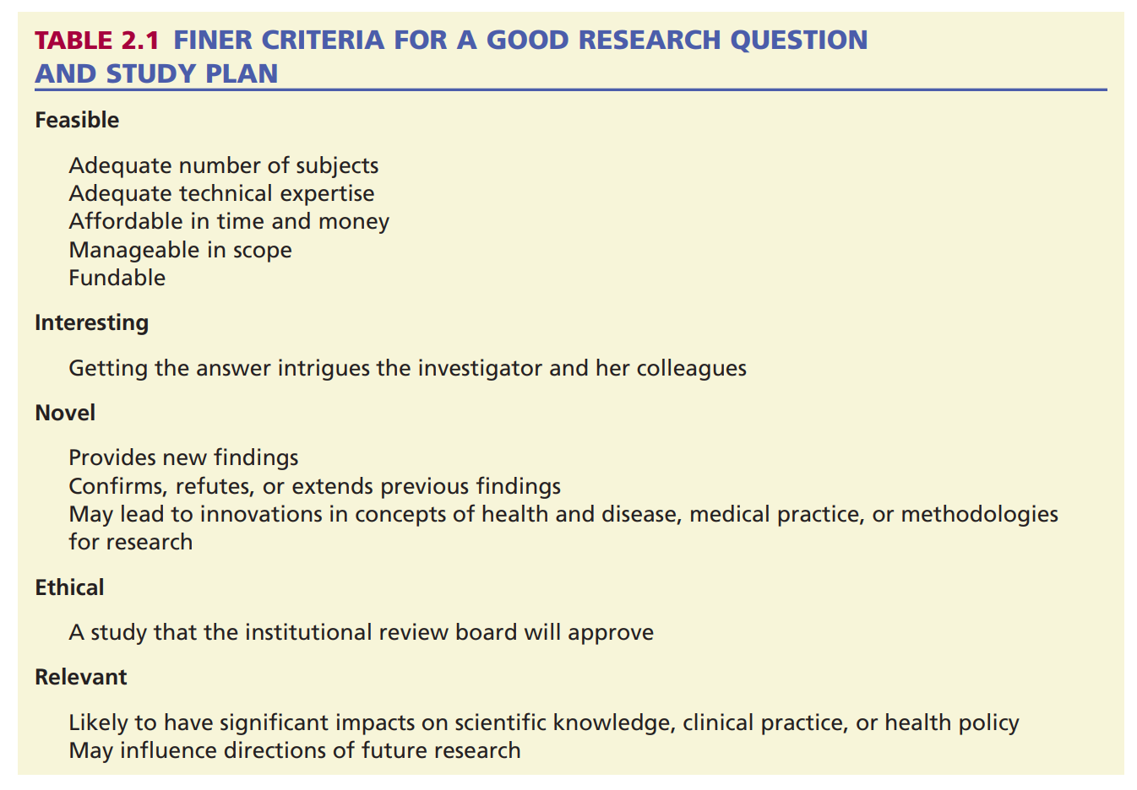
FINER Criteria
alt_text

